Slide 1

INDIVIDUAL • INDUSTRY-ORIENTED • 2026
Customer Journey Analytics Dashboard
End-to-End Customer Behaviour, Conversion & Revenue Analytics
Krishan Kumar Sharma · Excel · Python/Jupyter · MySQL · Power BI ·

Slide 2
End-to-End Solution Architecture
The workflow is deliberately sequential: data-quality work precedes SQL aggregation, and SQL findings are communicated through Power BI.
01
02
Raw Excel Data
Profiling & Cleaning
Initial dataset understanding
Python/Jupyter standardization
03
04
Analytical Validation
MySQL & SQL Analysis
5,982 records confirmed
Business-focused queries
05
06
Power BI Dashboard
Insights & Recommendations
5 interactive pages
Decision support outputs

Slide 3

Dataset & Data Understanding
Session-Oriented Customer Journey Data
The dataset covers customer and visit attributes, demographics, device, traffic source, engagement, product/category information, cart and discount behaviour, purchase status, payment method, and satisfaction feedback.
5,982 Records
27 Columns
2,274 Purchases
Loaded into Power BI
Full analytical coverage
38.01% conversion rate

Slide 4

Data Profiling & Cleaning
Missing Values
Categorical Standardization
Gender (0.7%), City (0.6%), Traffic_Source (0.5%). Review_Rating & Customer_Satisfaction nulls treated as structurally non-applicable for non-purchasing sessions.
Product_Category, Gender and City had inconsistent labels (e.g., "fashion" vs "Fashion", "MUMBAI" vs "Mumbai") — consolidated for reliable grouping.
Duplicate Handling
Duplicates explicitly checked and removed. Final analytical boundary: 5,982 records × 27 columns confirmed for SQL and Power BI.

Slide 5

MySQL & SQL Analysis
The validated dataset was imported into MySQL for reproducible business analysis across purchase, conversion, traffic, category, revenue and payment dimensions.
Key SQL Findings
Area | Result
Purchased Sessions | 2,274 Yes / 3,708 No
Overall Conversion | 38.01%
Total Revenue | ₹23,454,694
Avg Purchase Value | ₹10,314.29
Top Payment Method | Credit Card (477 purchases)
Payment-method output contains two UPI-labelled rows — a residual label inconsistency requiring standardization.

Slide 6
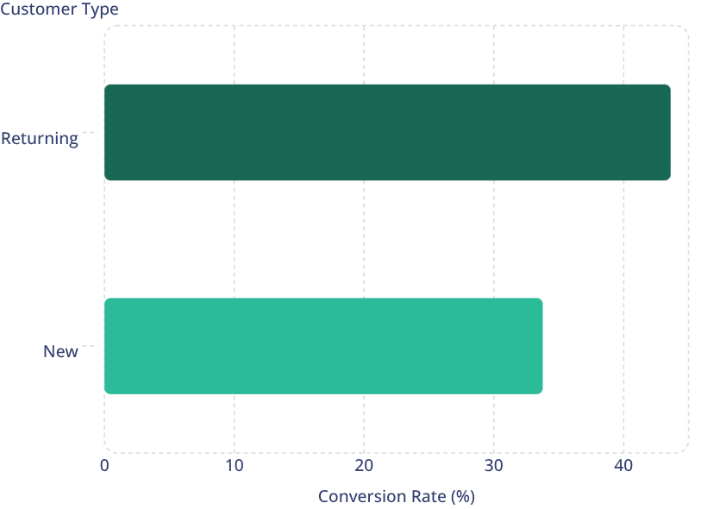
Conversion Analysis
Customer Type Conversion
Returning customers convert at 43.62% vs 33.77% for new customers — a 9.85 percentage-point gap.
Traffic Source Conversion
Facebook leads at 40.42%, followed by Google (38.37%), Email (38.15%), Direct (37.97%), Instagram (37.77%), YouTube (36.74%), and Referral (36.65%). Unknown sources show only 23.33%.

Slide 7
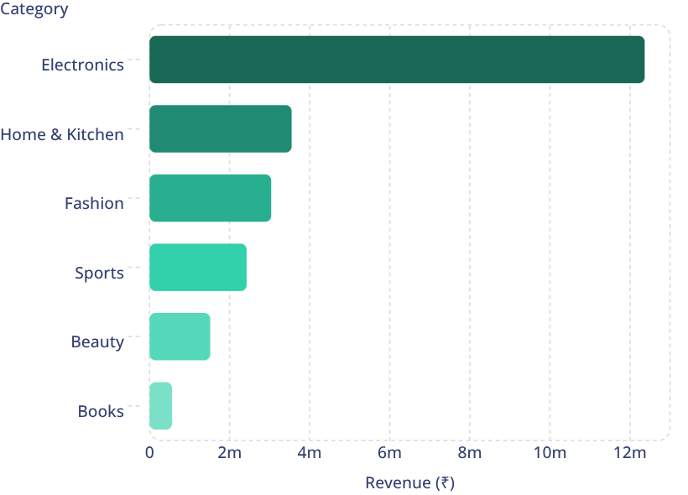
Revenue by Product Category
Electronics Dominates Revenue
Electronics contributes ₹12,366,407 — roughly 52.7% of total SQL revenue — with an average purchase value of ₹25,871.
Fashion leads purchase volume at 572 transactions, but Electronics leads in revenue. Beauty and Books show lower revenue despite competitive conversion rates.

Slide 8





Power BI Dashboard — 5 Pages
1. Customer Journey Overview
2. Customer Behaviour Analysis
3. Purchase Analysis
4. Traffic & Revenue Analysis
Executive KPIs: 2.058K customers, 23M revenue, 38.01% conversion, 5.982K sessions.
Transaction trends, payment methods, discount usage and category-level revenue.
Acquisition channel quality, device-level performance and conversion comparisons.
Segmentation by customer type, device, gender and traffic source with session duration.
5. Key Insights
Decision-oriented summary of conversion, revenue, category and traffic findings.

Slide 9


Integrated Business Insights
Overall Conversion: 38.01%
Returning Customers Outperform
Facebook Converts, Google Earns
2,274 purchases across 5,982 sessions — a strong baseline for e-commerce benchmarking.
43.62% vs 33.77% conversion — a 9.85 pp gap makes retention a high-value lever.
Facebook leads conversion at 40.42%; Google leads revenue at ₹6,081,848.
Electronics: 52.7% of Revenue
Mobile Dominates Sessions
High revenue concentration creates opportunity but also introduces commercial risk.
70% of sessions on Mobile; Desktop shows highest conversion rate at 40.87%.

Slide 10

Recommendations & Conclusion
Key Recommendations
Project Conclusion
Use returning-customer behaviour as a benchmark for retention initiatives.
This end-to-end analytics project transforms raw customer journey data into validated SQL outputs and an interactive Power BI dashboard — establishing traceability from data quality through to decision support.
Strongest findings: 38.01% conversion, returning-customer advantage, Facebook conversion leadership, Google revenue leadership, Electronics revenue dominance, Fashion volume leadership.
Evaluate Facebook for conversion efficiency; Google for revenue contribution.
Monitor Electronics revenue concentration risk while sustaining growth.
Strengthen categorical standardization rules in future data pipelines.

